Slide 1



Slide 2
Contents
1
Revision
2
State Space Graph
3
Depth First Search
4
Breadth First Search

Slide 3
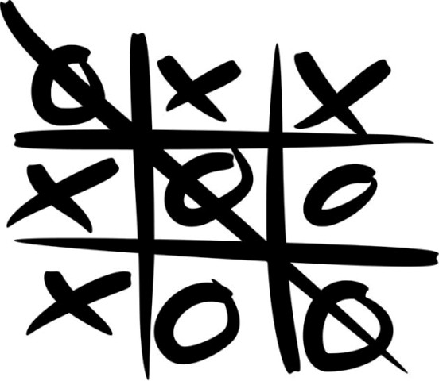
How can I win at Tic-Tac-Toe?

Slide 4
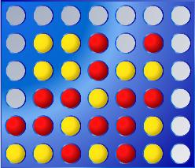
How can I win at Connect 4?

Slide 5
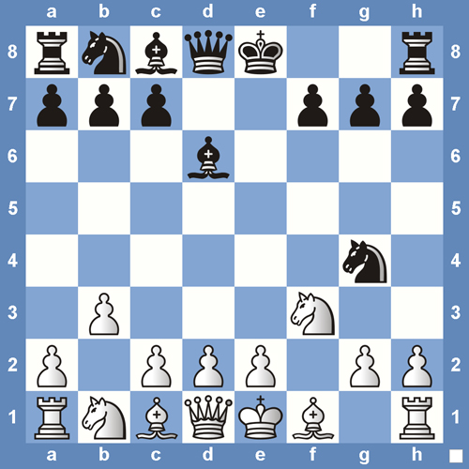
How can I win at Chess?

Slide 6
A Solution ….
Us an Artificial Intelligence (AI) technique:
  State Space Search

Slide 7
State Space Search
A state refers to the status of a puzzle or game at a given moment.
In solving a puzzle or a problem one starts from some initial state and tries to reach a goal state by passing through a series of intermediate states.
If you think of each state being connected to those states which can follow from it, you have a graph -> a state space graph.

Slide 8
State Space Search
A computer program may start from an initial state, then look at one of its children states and so on until it reaches a goal state.
It may reach a dead end state from where it cannot proceed -> the program may “backtrack”, i.e. undo its last move and try an alternative child to its previous state.
A path from the initial state to the goal state constitutes a solution.

Slide 9
State Space Searches
A
A state space search starts at the root and explores nodes from there, looking for a goal node (a node that satisfies certain conditions, depending on the problem)
B
C
D
E
F
G
H
I
J
K
L
M
N
O
P
Q
Goal nodes

Slide 10
State Space Searches
A
For some problems, any goal node is acceptable (N or J); for other problems, you want a minimum-depth goal node, that is, a goal node nearest the root (only J)
B
C
D
E
F
G
H
I
J
K
L
M
N
O
P
Q
Goal nodes

Slide 11
Two Path Finding Algorithms
2 State Space Searches:
DEPTH-FIRST search
BREADTH-FIRST search

Slide 12
Two Path Finding Algorithms
DEPTH-FIRST search
Examine a state, then proceeds from it to one of its child states and then repeats this process with the child state.

Slide 13
Two Path Finding Algorithms
BREADTH-FIRST search
Examines all the child states of a given level before proceeding to a new level.

Slide 14
Depth-first searching
After searching A, then B, then D, the search backtracks and tries another path from B
Node are explored in the order A B D E H L M N I O P C F G J K Q
N will be found before J
A
B
C
D
E
F
G
H
I
J
K
L
M
N
O
P
Q

Slide 15
Breadth-first searching
After searching A, then B, then C, the search proceeds with D, E, F, G
Node are explored in the order A B C D E F G H I J K L M N O P Q
J will be found before N
A
B
C
D
E
F
G
H
I
J
K
L
M
N
O
P
Q

Slide 16
Algorithms for both state searches

Slide 17

Reminder: What is a stack?
LIFO: Last In First Out

Slide 18
Depth-first searching algorithm
Put the root node on a stack
while (stack is not empty)
remove a node from the stack
if (node is a goal node)
return success
put all children of node onto the stack
return failure

Slide 19
Implementing Depth-first searching
A
A
Put the root node on a stack;
B
C
remove a node from the stack;
D
E
F
G
Is A = J or N? => NO
B
C
H
I
J
K
put all children of node onto the stack;
L
M
N
O
P
Q
Can you finish off this illustration?

Slide 20

Reminder: What is a queue?
FIFO: First In First Out

Slide 21
Breadth-first searching algorithm
Put the root node on a queue
while (queue is not empty)
remove a node from the queue
if (node is a goal node)
return success
put all children of node onto the queue
return failure

Slide 22
Implementing Breadth-first searching
A
A
Put the root node on a queue;
B
C
remove a node from the queue;
D
E
F
G
Is A = J or N? => NO
B | C
put all children of node onto the queue;
H
I
J
K
L
M
N
O
P
Q
Can you finish off this illustration?

Slide 23
Depth- vs. Breadth-first searching
When a breadth-first search succeeds, it finds a minimum-depth (nearest the root) goal node
When a depth-first search succeeds, the found goal node is not necessarily minimum depth
For a large tree, a depth-first search may take an excessively long time to find even a very nearby goal node

Slide 24
Thank You !

